Slide 1
Data for NIL Deals of College Athletes
Tyler Pooley

Slide 2
Scope of Project
Topic: Name, Image, Likeness (NIL) deals in college athletics
Current environment:
“Wild West” with little regulation
Limited data availability & consolidation
Objective: gather data about college athletes’ NIL and consolidate into data set that can be used for analyses

Slide 3
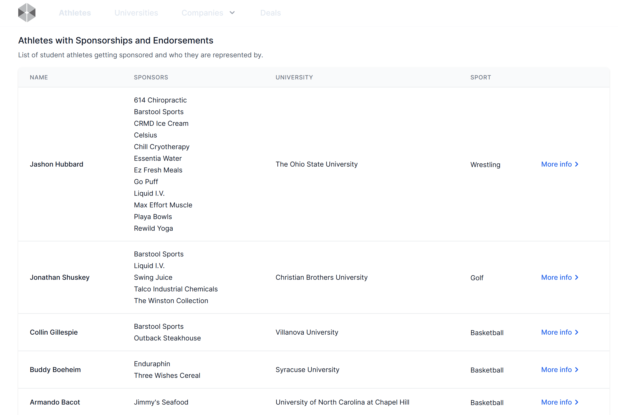
Scope of Project
Site used: https://nilcollegeathletes.com/athletes?page=1

Slide 4
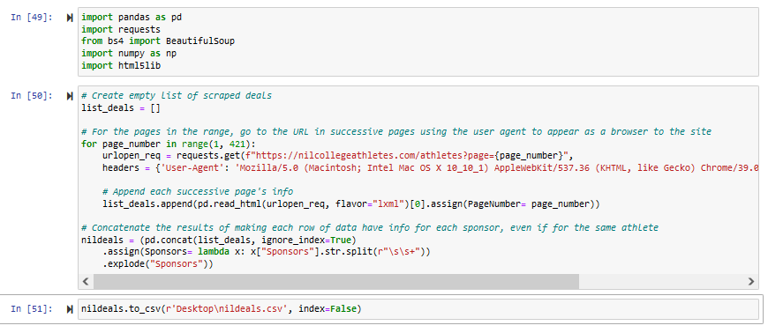
Code Used

Slide 5
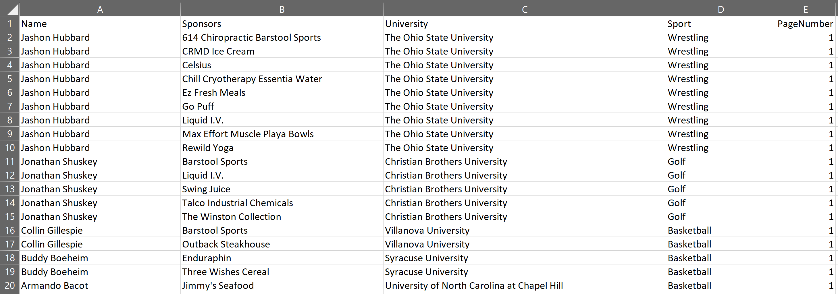
Final Results
8,453 complete rows of data, even if athlete has multiple sponsors
“PageNumber” column added for ease of finding results on the site if desired

Slide 6
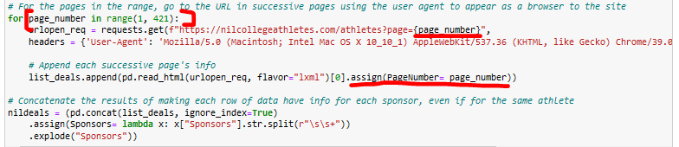
Challenges
Needing a user agent to access the site
Getting the code to go to the next pages until the end

Slide 7
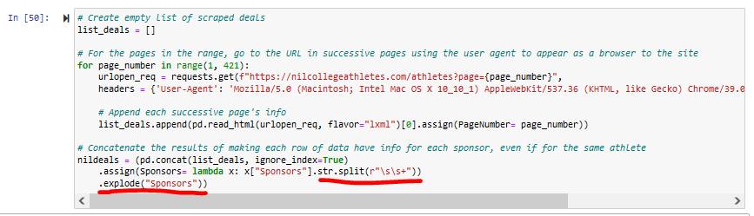
What I Learned
Use a user agent
Not having one is an easy way for sites to know it’s a person trying to access the site rather than a browser
Reminders of concepts from this course
Starting small and building out is the way to go, especially for time-intensive operations
There’s usually a function/method/library/etc. that already does what is desired
Explode and split methods, in my case

Slide 8
What Would I Do Differently?
Research and define the scope of the project better
Be realistic
What’s feasible?
Is the data even there enough to be worth obtaining?

Slide 9
Fun Facts from the Data
Sports with the most deals:
Football – 1,885
Baseball – 1,037
Soccer - 866
Lacrosse - 628
Basketball – 614
Sports with the least amount of deals:
Bowling – 3
Rifle – 3
Esports – 2
Water Skiing - 1
Paralympic Swimming - 1

Slide 10
Fun Facts from the Data
Schools with the most athletes with NIL deals:
An Ohio State University - 126
Michigan - 100
Michigan State University – 82
Alabama – 73
Penn State – 69
Nebraska is #25 with 55 athletes with NIL deals

